Slide 1
3.2 Exercises
Ori Rinaman
Bellevue University

Slide 2
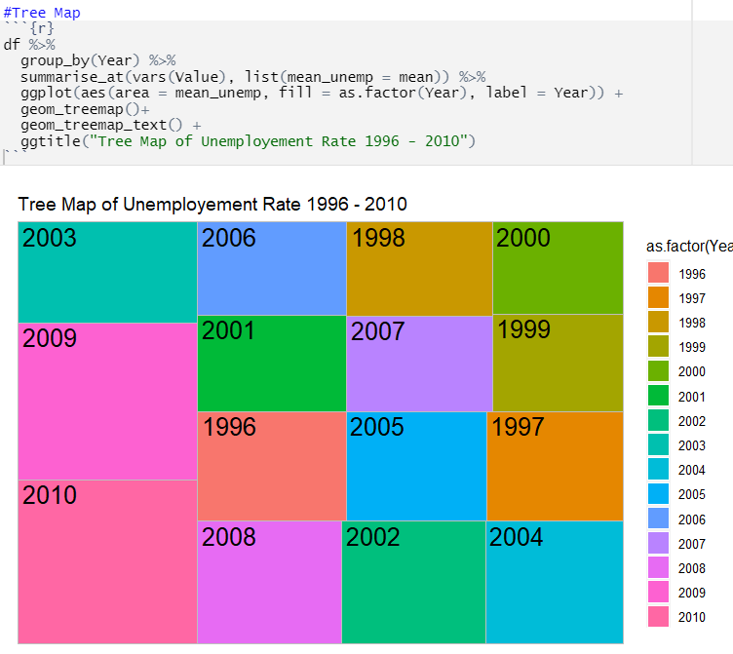
Tree Map (R)

Slide 3
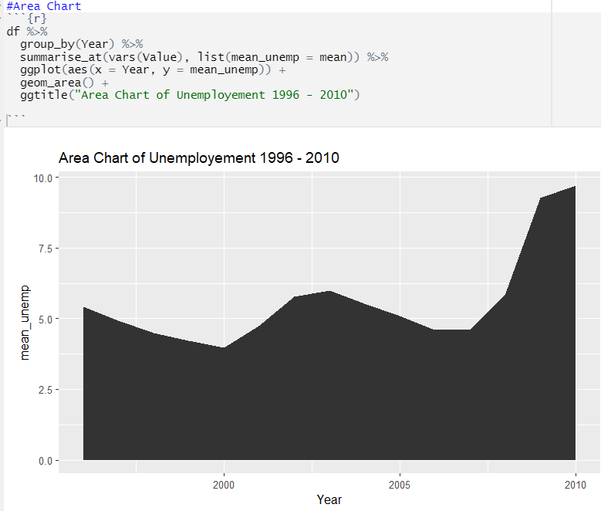
Area Chart (R)

Slide 4
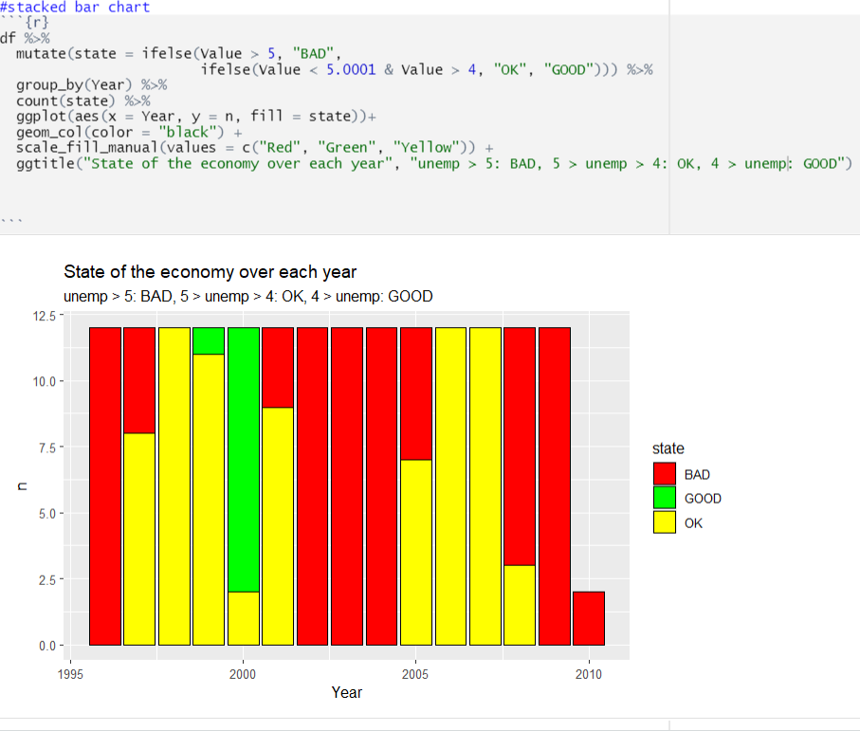
Stacked Bar (R)

Slide 5
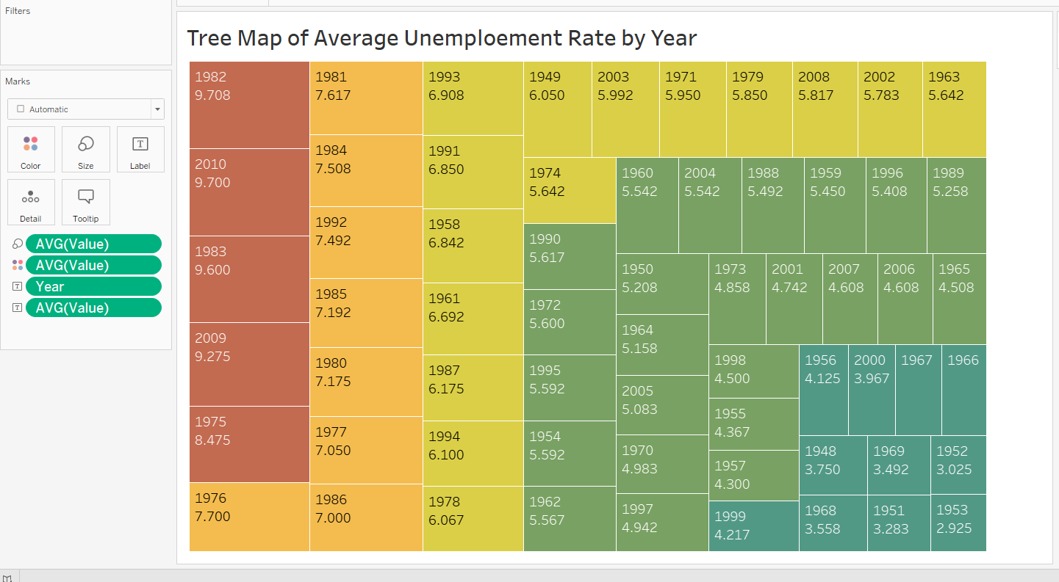
Tree Map (Tableau)

Slide 6
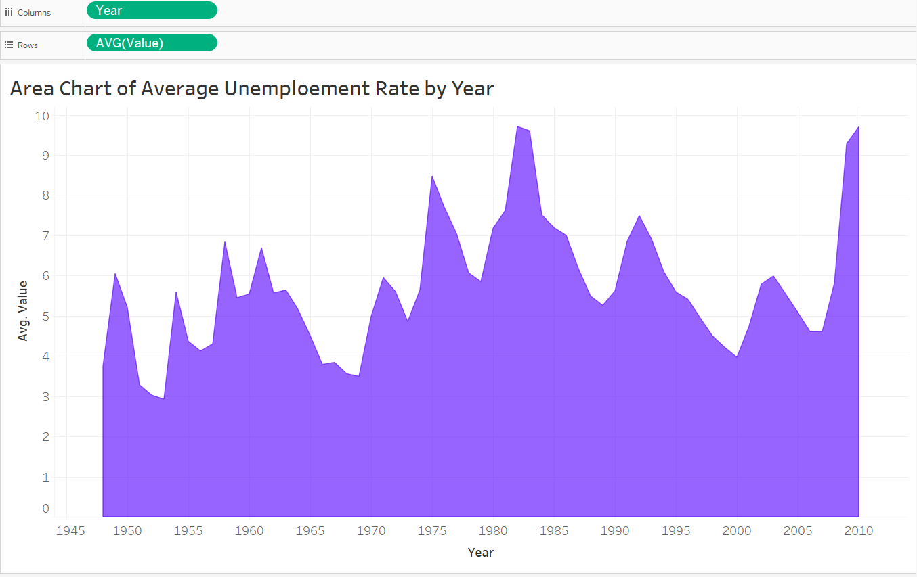
Area Chart (Tableau)

Slide 7
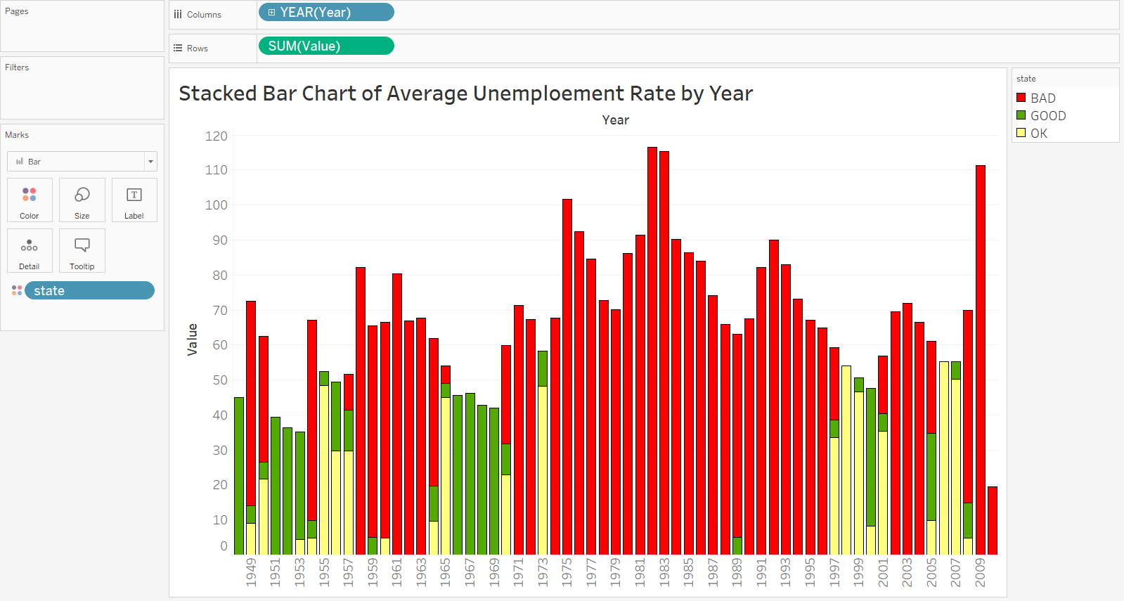
Stacked Bar (Tableau)

Slide 8
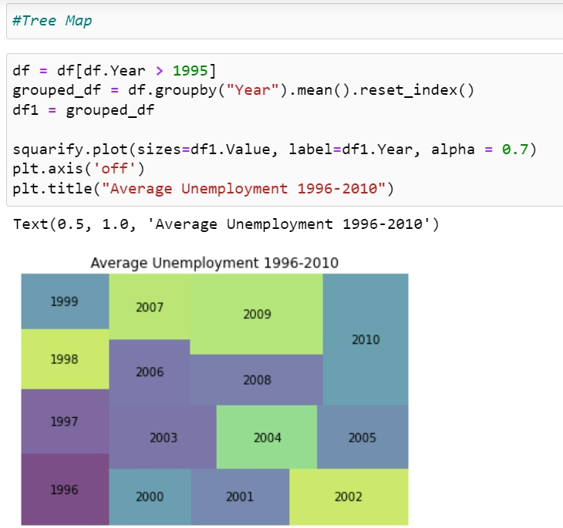
Tree Map (Python)

Slide 9
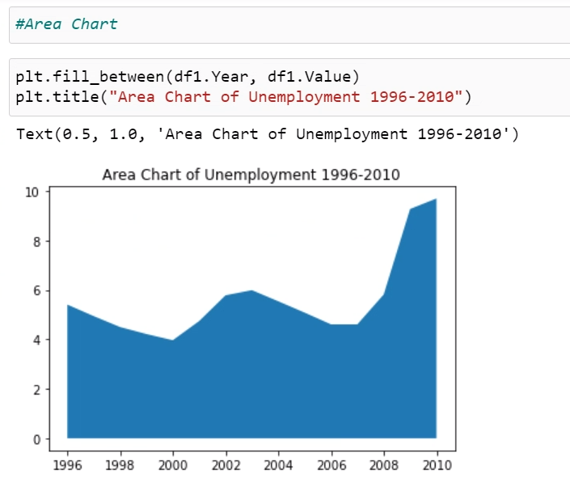
Area Chart (Python)

Slide 10
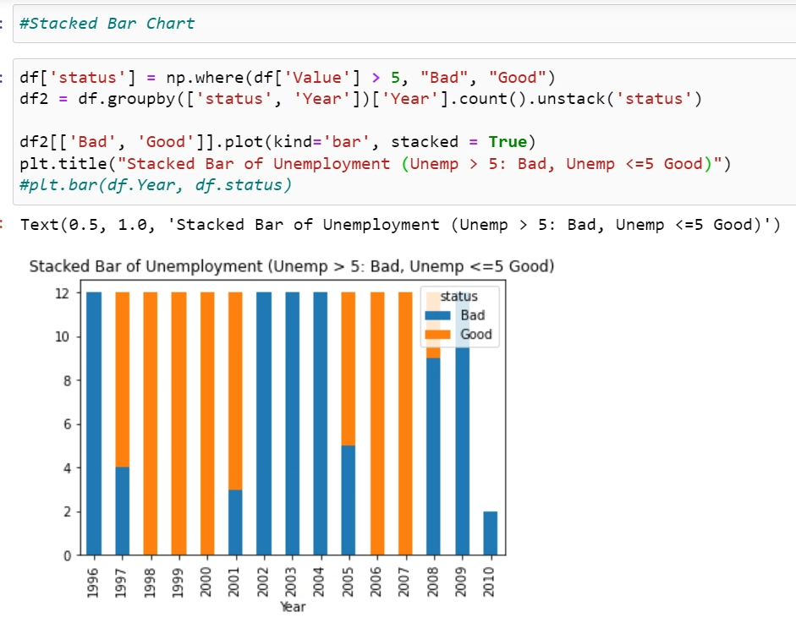
Stacked Bar (Python)

